Slide 1
Defensive Security Project
by: Group 6

Slide 2

Monitoring Environment
2

Slide 3
Whois XML IP Geolocation API
3

Slide 4
Whois XML IP Geolocation API
Add on for Splunk that gives more detailed ip information
Can be used to counter ip obfuscation tools such as VPNs, proxies and TOR

Slide 5
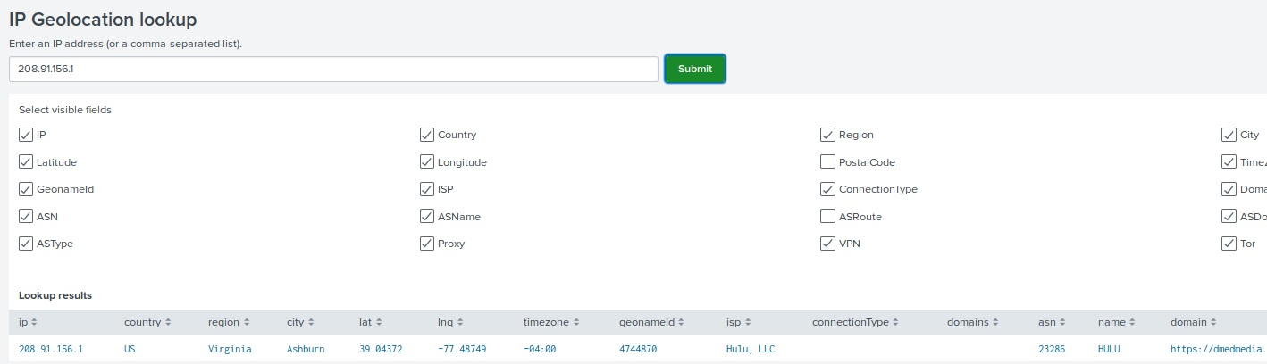
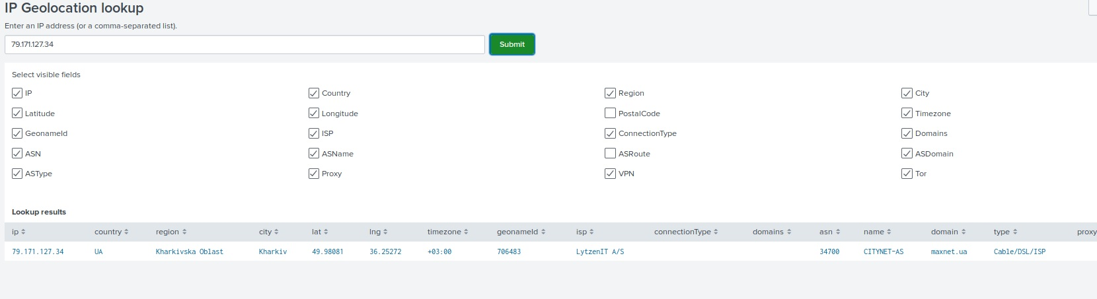
[Add-On App Name]
[Images for add-on app.]

Slide 6
Windows Logs
6

Slide 7
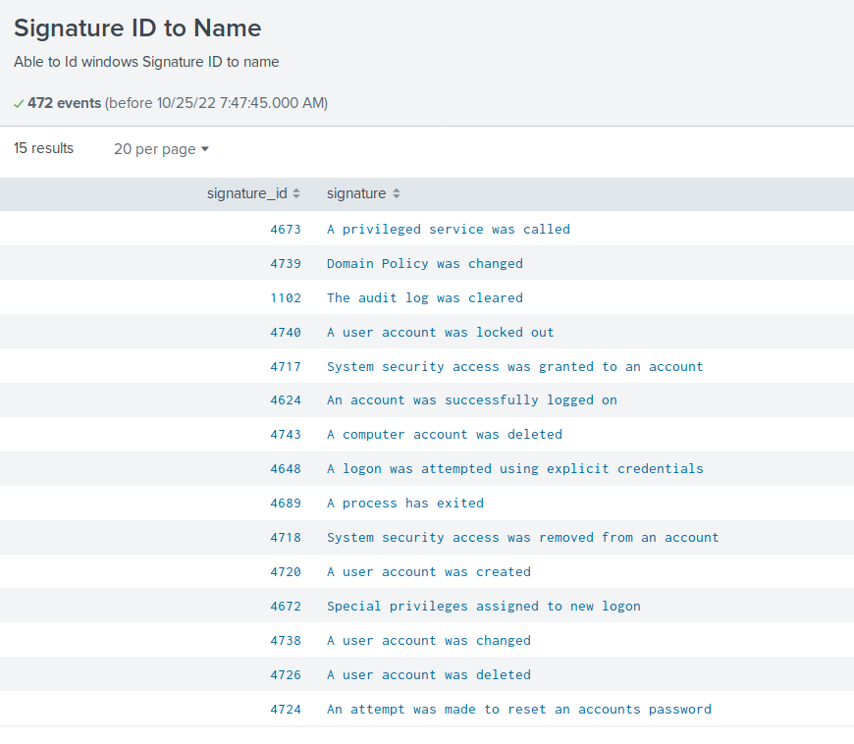
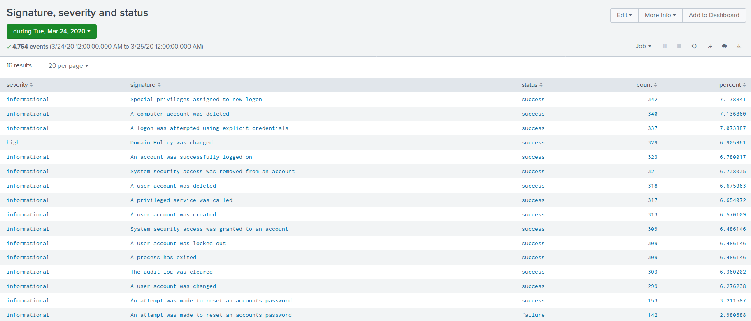
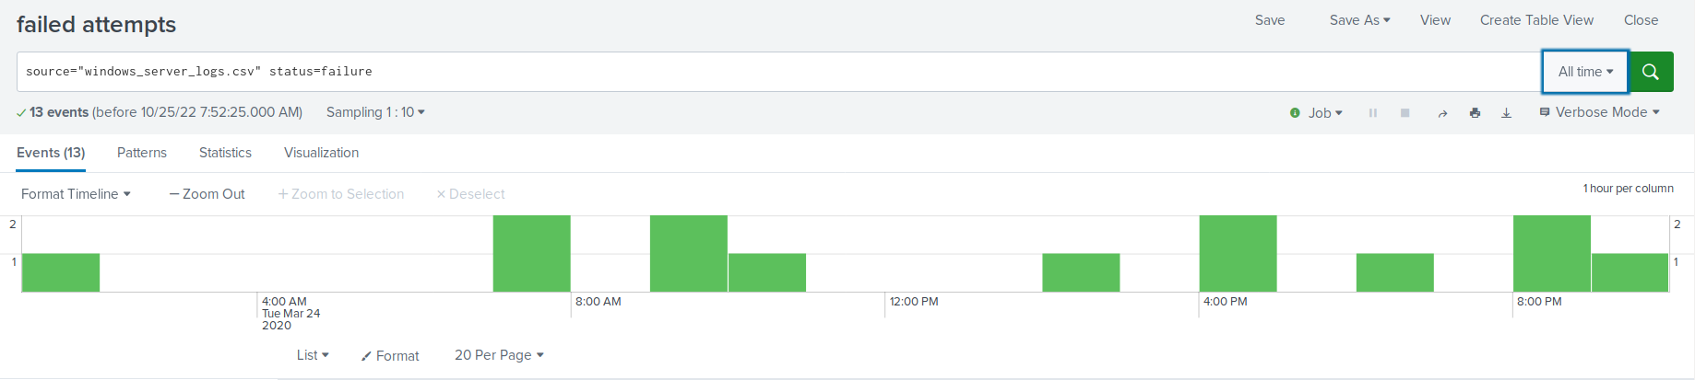
Images of Reports—Windows
Report Image
Report Image
Report Image
Report Image

Slide 8
Alerts—Windows
Designed the following alerts:
Alert Name | Alert Description | Alert Baseline | Alert Threshold
Unusual Excessive Activity - Users Deleted | Alerts when the number of users deleted within an hour reaches 18 or above | 16 | 18

Slide 9
Alerts—Windows
Unusual Excessive Activity - Users Deleted Rule Justification
Baseline was the average over the course of the day
The threshold was chosen to avoid alert fatigue

Slide 10
Alerts—Windows
Designed the following alerts:
Alert Name | Alert Description | Alert Baseline | Alert Threshold
Unusual Excessive Activity - Successful Logins | Alerts when too many successful login are made | 16 | 30

Slide 11
Alerts—Windows
Unusual Excessive Activity - Failed Windows Activity Rule Justification
Baseline was chosen as its the average over the course of the day
The threshold was considerably higher as it can vary quite a bit of login through out the day.

Slide 12
Alerts—Windows
Designed the following alerts:
Alert Name | Alert Description | Alert Baseline | Alert Threshold
Unusual Excessive Activity - Failed Windows Activities | An alert for when the amount of windows activities per hour with the code failed reaches the threshold | 8 | 10

Slide 13
Alerts—Windows
Excessive Failed Windows Activity Rule Justification
Baseline was an average of the course of the day
Alert threshold was quite low as there should not be a high number of failed windows activities

Slide 14
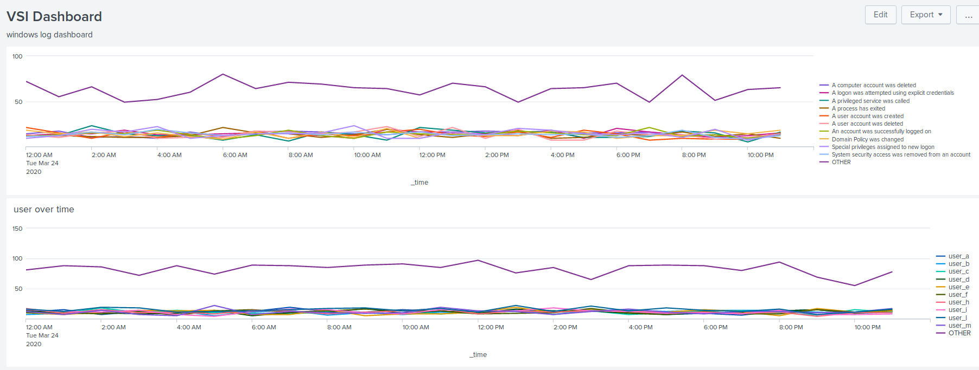
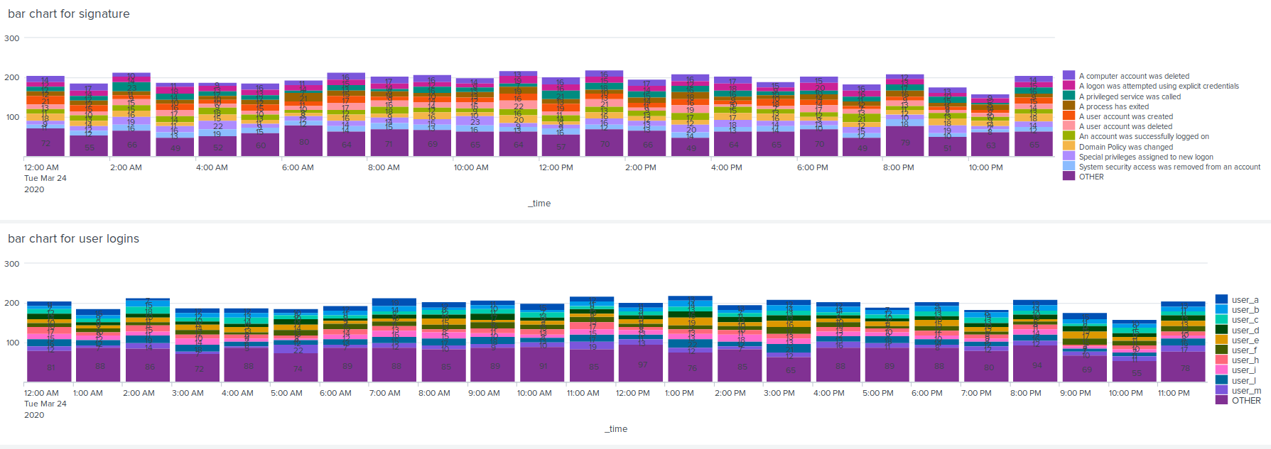
Dashboards—Windows
Place image here
Place image here
Place image here
Place image here

Slide 15
Apache Logs
15

Slide 16
Reports—Apache
Designed the following reports:
Report Name | Report Description
HTTP activity and count | shows the http method and the count of each
show the reference domains | shows the different domains that referenced the webapp

Slide 17
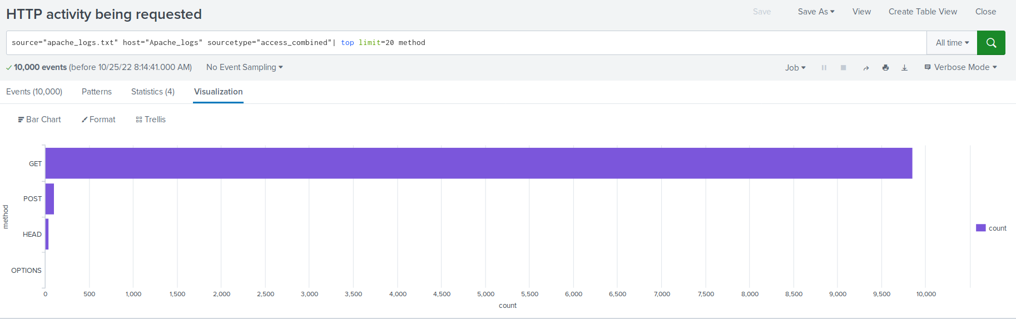
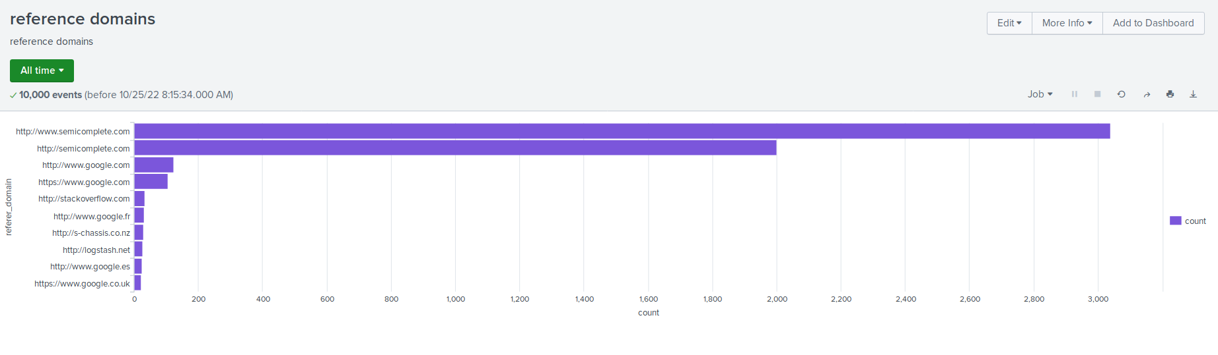
Images of Reports—Apache
Report Image
Report Image

Slide 18
Alerts—Apache
Designed the following alerts:
Alert Name | Alert Description | Alert Baseline | Alert Threshold
excessive http: POST | excessive HTTP: POST responses from server | 7 | 10
JUSTIFICATION: Baseline is the average over the course of the logos
threshold is set steady at slightly higher than the base line. These type of request does not fluctuate a great deal.

Slide 19
Alerts—Apache
Designed the following alerts:
Alert Name | Alert Description | Alert Baseline | Alert Threshold
Unusual International Traffic | Excess of inbound traffic, possible DDOS | 133 | 150 in 1 hour
JUSTIFICATION: A sudden increase may be an indicator of a denial of service attack

Slide 20
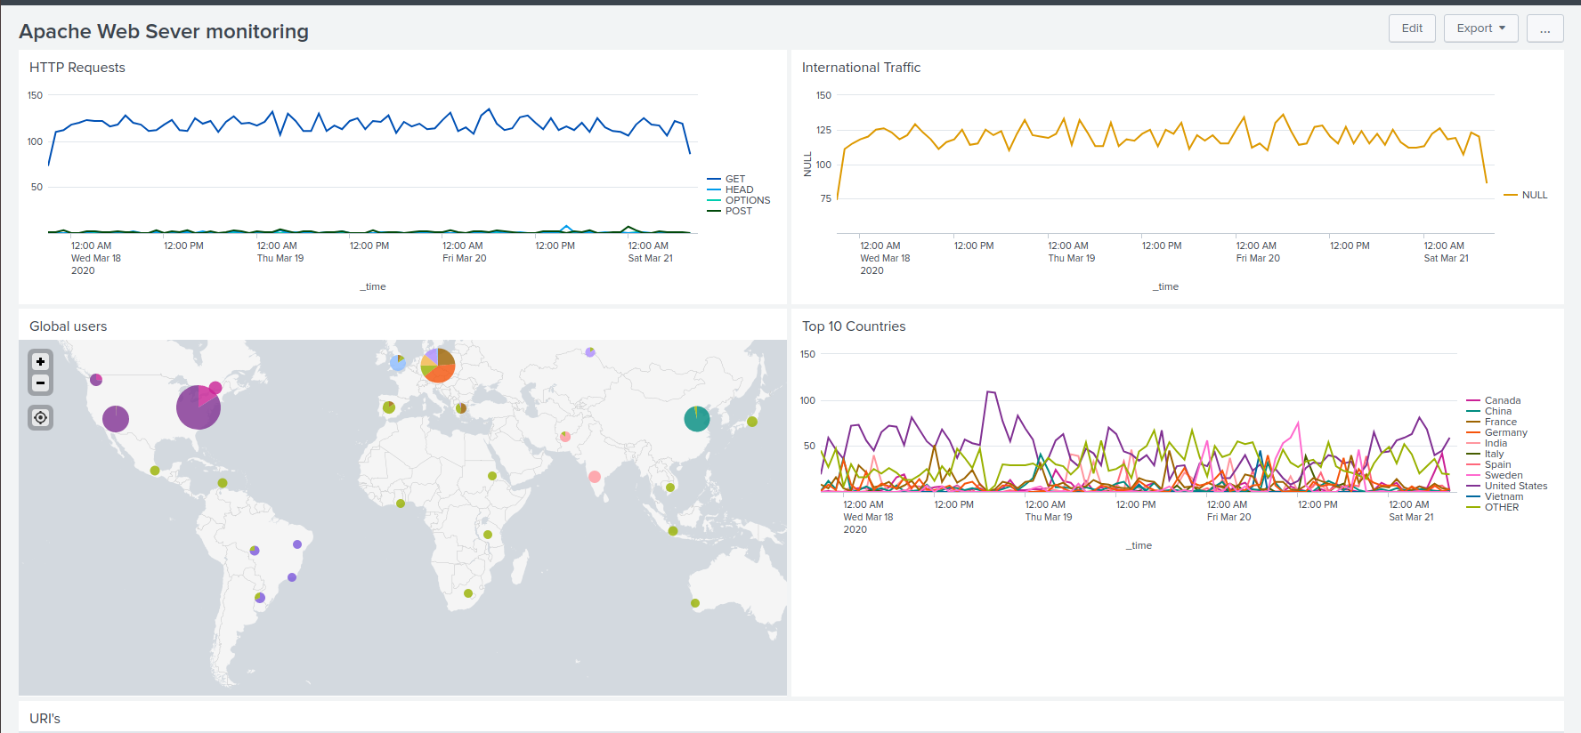
Dashboards—Apache

Slide 21
Attack Analysis
21

Slide 22
Attack Summary—Windows
Summarize your findings from your reports when analyzing the attack logs.
There was an attack where threat was attemting to gain access by reseting passwords
It seems like they were successful looking at the extreme high number of successful logins.
there was also indication of a high number of failed windows events at 8am

Slide 23
Attack Summary—Windows
Summarize your findings from your alerts when analyzing the attack logs. Were the thresholds correct?
there was an alert for 11am 25/03/20 was an excessive number of successful logins indicating the windows system was under attack.

Slide 24
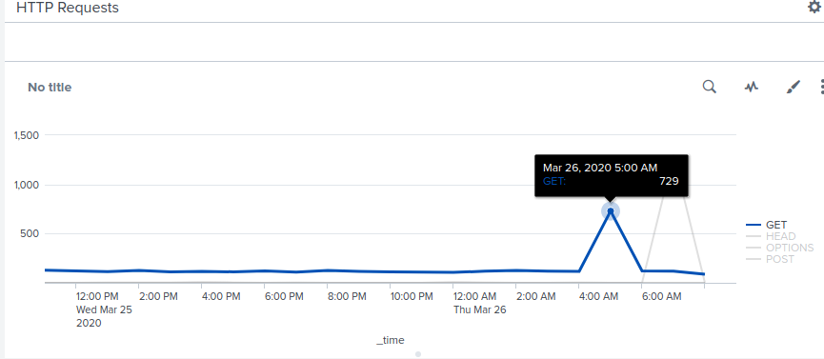
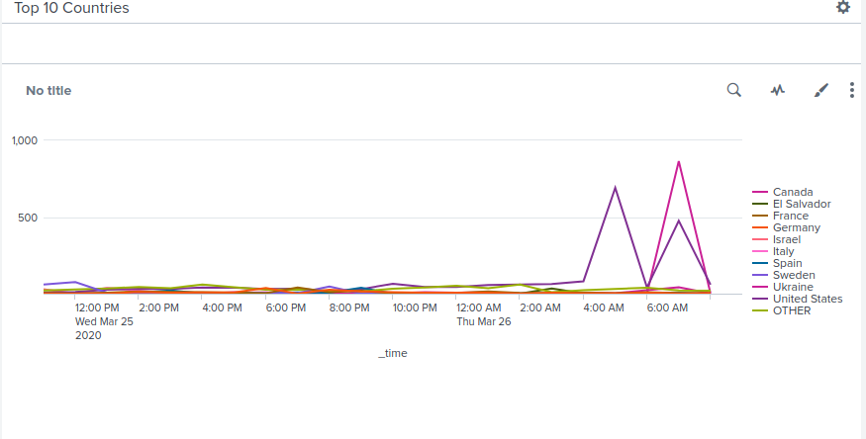
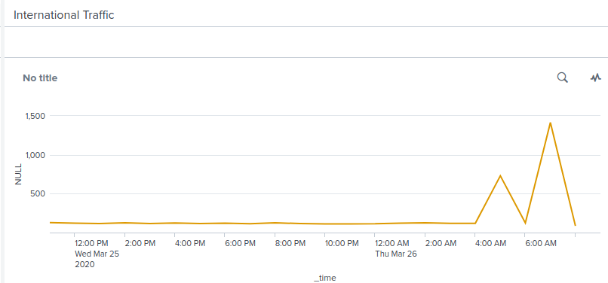
Attack Summary—Apache
Thresholds alerted us to the attack successfully
Clear increase in GET and POST requests sent to the Apache servers
While a Initial spike was based from almost entirely within US, majority of POST requests came from Ukraine

Slide 25
Attack Summary—Apache
While a Initial spike was based from almost entirely within US, majority of POST requests came from Ukraine

Slide 26
Summary and Future Mitigations
26

